Slide 1
Use Cases
A use case is a description of a set of sequences of actions, including variants, that a system performs to yield an observable result of value to an actor.
Graphically, a use case is rendered as an ellipse.

Slide 2
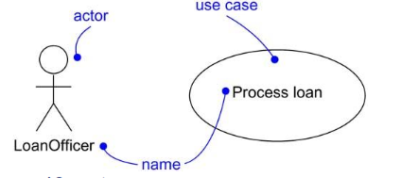

Slide 3
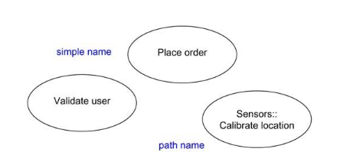
In practice, use case names are short active verb phrases naming some behavior found in the vocabulary of the system you are modeling.

Slide 4
Use Cases
What is a Use Case
  A formal way of representing how a business system interacts with its environment
  Illustrates the activities that are performed by the users of the system
  A scenario-based technique in the UML
  A sequence of actions a system performs that yields a valuable result for a particular actor.

Slide 5
Actor
What is an Actor?
  A user or outside system that interacts with the system being designed in order to obtain some value from that interaction
Use Cases describe scenarios that describe the interaction between users of the system (the actor) and the system itself.
Typically an actor represents a role that a human, a hardware device or even other system plays with a system.

Slide 6
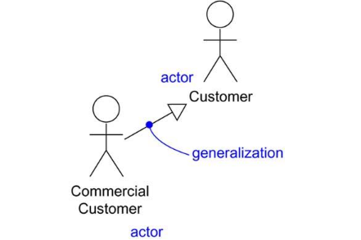

Slide 7
Use Cases
Use case diagrams describe what a system does from the standpoint of an external observer. The emphasis is on what a system does rather than how.
Use case diagrams are closely connected to scenarios. A scenario is an example of what happens when someone interacts with the system.

Slide 8
Use Cases
Here is a scenario for a medical clinic.
A patient calls the clinic to make an appointment for a yearly checkup. The receptionist finds the nearest empty time slot in the appointment book and schedules the appointment for that time slot. "
We want to write a use case for this scenario.
Remember: A use case is a summary of scenarios for a single task or goal.

Slide 9
Use Cases
Step 1 Identify the actors
As we read the scenario, define those people or systems that are going to interact with the scenario.
A patient calls the clinic to make an appointment for a yearly checkup. The receptionist finds the nearest empty time slot in the appointment book and schedules the appointment for that time slot. "

Slide 10
Use Cases
Step 1 Identify the actors
As we read the scenario, define those people or systems that are going to interact with the scenario.
A patient calls the clinic to make an appointment for a yearly checkup. The receptionist finds the nearest empty time slot in the appointment book and schedules the appointment for that time slot. "

Slide 11
Questions for Identifying People Actors
Who is interested in the scenario/system?
Where in the organization is the scenario/system be used?
Who will benefit from the use of the scenario/system?
Who will supply the scenario/system with this information, use this information, and remove this information?
Does one person play several different roles?
Do several people play the same role?
Notes:
Actors
7) Does one person play several different roles?
May have an actor for each role
8) Do several people play the same role?
Only use one actor per role (no matter how many people play that role)
Identifying actors is an iterative process
Defining how an actor interacts with the system may clarify whether there are duplicate actors or not

Slide 12
Questions for Identifying Other Actors
What other entity is interested in the scenario/system?
What other entity will supply the scenario/system with this information, use this information, and remove this information?
Does the system use an external resource?
Does the system interact with a legacy system?
Notes:
Actors
7) Does one person play several different roles?
May have an actor for each role
8) Do several people play the same role?
Only use one actor per role (no matter how many people play that role)
Identifying actors is an iterative process
Defining how an actor interacts with the system may clarify whether there are duplicate actors or not

Slide 13
Actors
An Actor is outside or external the system.
It can be a:
  Human
  Peripheral device (hardware)
  External system or subsystem
  Time or time-based event
Represented by stick figure
Notes:
Actors
Are NOT a part of the system (external to the system)
A single actor may represent multiple physical users
Whether human or not, represented by stick figure
MUST label stick figure with the name of the actor

Slide 14

Use Cases
So as we read our scenario, what or who is the actor????
A patient calls the clinic to make an appointment for a yearly checkup. The receptionist finds the nearest empty time slot in the appointment book and schedules the appointment for that time slot. "
The actor is a Patient.

Slide 15

Use Cases
The picture below is a Make Appointment use case for the medical clinic.
The actor is a Patient. The connection between actor and use case is a communication association (or communication for short).
Actors are stick figures. Use cases are ovals. Communications are lines that link actors to use cases.
Actors are stick figures. Use cases are ovals. Communications are lines that link actors to use cases.
Actors are stick figures. Use cases are ovals. Communications are lines that link actors to use cases.

Slide 16
Use Case Componentss
The use case has three components.
The use case task referred to as the use case that represents a feature needed in a software system.
The actor(s) who trigger the use case to activate.
The communication line to show how the actors communicate with the use case.
  (Actors may be connected to use cases only by association. An association between an actor and a use case indicates that the actor and the use case communicate with one another, each one possibly sending and receiving messages. )

Slide 17
Use Case - Relationships
Relationships
  Represent communication between actor and use case
  Depicted by line or double-headed arrow line
  Also called association relationship
Make
Appointment
Notes:
Use Case Relationship
Association relationship
May exist between actor and a use case
Often referred to as a communicate association
Navigable in both directions (actor to use case and use case to actor)
Some use just a line
Others use a double-headed arrowhead
Navigable in only one direction (actor to use case OR use case to actor)
Use a arrowhead where arrowhead denotes the direction of communication
Navigation direction of an association represents who is initiating the communication
Multiplicity
Not consistency shown on all use-case diagrams (Some do; some don’t)

Slide 18
Use Case - Relationships
Boundary
  A boundary rectangle is placed around the perimeter of the system to show how the actors communicate with the system.
Make
Appointment
Notes:
System boundary: A system boundary defines the scope of what a system will be. A system cannot have infinite functionality. So, it follows that use cases also need to have definitive limits defined. A system boundary of a use case diagram defines the limits of the system. The system boundary is shown as a rectangle spanning all the use cases in the system.
Other use cases in this lecture also show the system boundary of the clinic application. The use cases of this system are enclosed in a rectangle. Note that the actors in the system are outside the system boundary.
The system boundary is potentially the entire system as defined in the problem statement. But this is not always the case. For large and complex systems, each of the modules may be the system boundary. For example, for an ERP system for an organization, each of the modules such as personnel, payroll, accounting, and so forth, can form the system boundary for use cases specific to each of these business functions. The entire system can span all of these modules depicting the overall system boundary.

Slide 19
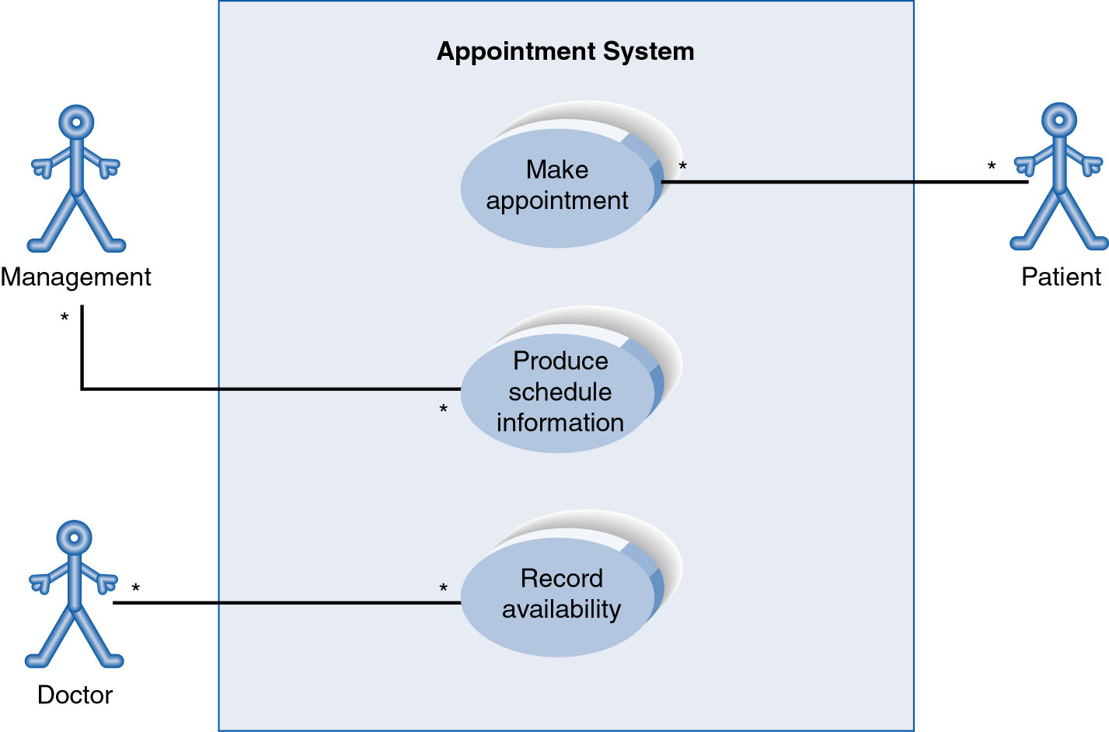
Use-Case Diagram
A use case diagram is a collection of actors, use cases, and their communications.
Notes:
Example Use Case
ACTORS
Represented by a stick figure
named
USE CASE
Represented by an oval
Named (POORLY NAMED; should be verb phrase)
RELATIONSHIP
2-way association

Slide 20
Use Case Diagram
Other Types of Relationships for Use Cases
  Generalization
  Include
  Extend
Notes:
Inheritance

Slide 21
Components of Use Case Diagram
Generalization Relationship
  Represented by a line and a hollow arrow
    From child to parent
Child use case
Parent use case
Notes:
Inheritance
A use case generalization shows that one use case is simply a special kind of another.
A clinic may have a use case such as Pay Bill which would be a parent use case and Bill Insurance which is the child.
A child can be substituted for its parent whenever necessary.
Generalization appears as a line with a triangular arrow head toward the parent use case.

Slide 22
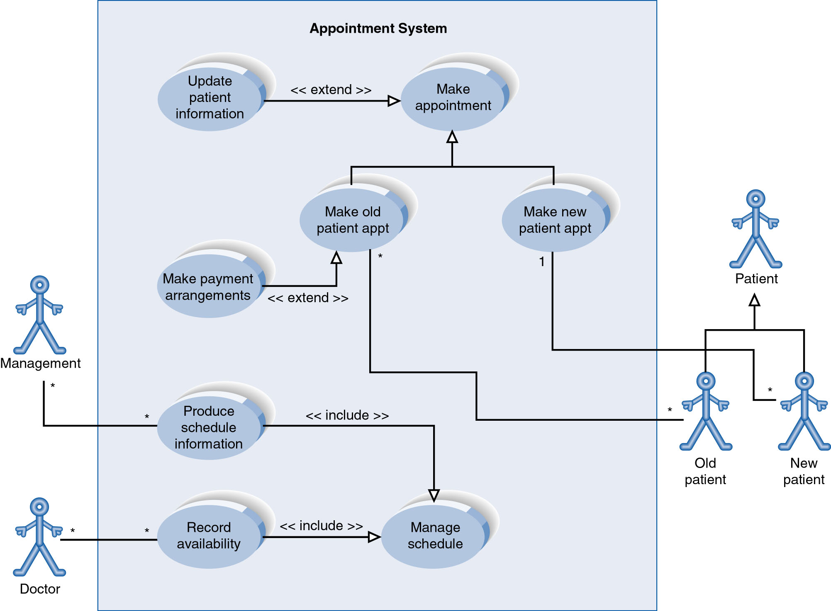
Example of Relationships
Notes:
System Boundary
Use cases are enclosed within a system boundary
a box that represents the system and clearly delineates what parts of the diagram are external or internal to it
Name of the system can appear inside or on top of the box

Slide 23
Use Case Diagram
Include Relationship
  Represents the inclusion of the functionality of one use case within another
  Arrow is drawn from the base use case to the used use case
  Write << include >> above arrowhead line
Notes:
Include relationship
Notice that ONLY between use cases (not between actors)
MANDATORY functional
Multiple use cases may share pieces of the same functionality
Rather than have duplicate functionality in several use cases
Put shared functionality in one use case and show relationship between it and other use cases that “uses” its functionality
Depicted by arrowhead with word “<<include>>” above it
Include relationships factor use cases into additional ones.
Includes are especially helpful when the same use case can be factored out of two different use cases.
If a clinic had a cases of Make Appointment and Request Medication.
Both might include Check Patient Record as a subtask.
Both would include a call to the use case Check Patient Record.
We don’t want to write it twice we simply want to include in as a call from both.
In the diagram,
include notation is a dotted line beginning at base use case ending with an arrows pointing to the include use case.
The dotted line is labeled <<include>>.

Slide 24
Use Case Diagram
Extend relationship
  Represents the extension of the use case to include optional functionality
  Arrow is drawn from the extension use case to the base use case
  Write << extend >> above arrowhead line
Notes:
Use Case Relationship
Extend relationship
Used to show optional behavior (behavior that is run only under certain circumstances)
Depicted by arrowhead with word “<<extend>>” above it
An extend relationship indicates that one use case is a variation of another.
This is often used when much of the same code may be in both only one extends the functionality somewhat.
A typical example is a add record to the database and modify that record.
So an add student is similar to a modify student so I may reuse some of the code.
Extend notation is a dotted line, labeled <<extend>>, and with an arrow toward the base case.
The extension point, which determines when the extended case is appropriate, is written inside the base case.

Slide 25
Example of Relationships
Notes:
System Boundary
Use cases are enclosed within a system boundary
a box that represents the system and clearly delineates what parts of the diagram are external or internal to it
Name of the system can appear inside or on top of the box

Slide 26
Use Case 1. Withdraw Money
The system displays the account types available to be withdrawn from and the user indicates the desired type. The system asks for the amount to be withdrawn and the user specifies it. Next, the system debits the user’s account and dispenses the money. The user removes the money, the system prints a receipt, and the user removes the receipt. Then the system displays a closing message and dispenses the user’s ATM card. After the user removes his card, the system displays the welcome message.
CMSC 345, Version 9/07
S. Mitchell

Slide 28
Use Case Specification Template*
Number
Name
Summary
Priority
Preconditions
Postconditions
Primary Actor(s)
Secondary Actor(s)
Trigger
Main Scenario | Step | Action
Extensions | Step | Branching Action
Open Issues
CMSC 345, Version 9/07
S. Mitchell
*Adapted from A. Cockburn, “Basic Use Case Template”

Slide 29
Use Case Specification Template*
Number | Unique use case number
Name | Brief noun-verb phrase
Summary | Brief summary of use case major actions
Priority | 1-5 (1 = lowest priority, 5 = highest priority)
Preconditions | What needs to be true before use case “executes”
Postconditions | What will be true after the use case successfully “executes”
Primary Actor(s) | Primary actor name(s)
Secondary Actor(s) | Secondary actor name(s)
Trigger | The action that causes this use case to begin
Main Scenario | Step | Action
 | Step # | This is the “main success scenario” or “happy path.”
 | … | Description of steps in successful use case “execution”
 | … | This should be in a “system-user-system, etc.” format.
Extensions | Step | Branching Action
 | Step # | Alternative paths that the use case may take
Open Issues | Issue # | Issues regarding the use case that need resolution
CMSC 345, Version 9/07
S. Mitchell
*Adapted from A. Cockburn, “Basic Use Case Template”

Slide 30
Use Case Specification Template Example
Number | 1
Name | Withdraw Money
Summary | User withdraws money from one of his/her accounts
Priority | 5
Preconditions | User has logged into ATM
Postconditions | User has withdrawn money and received a receipt
Primary Actor(s) | Bank Customer
Secondary Actor(s) | Customer Accounts Database
Continued …
CMSC 345, Version 9/07
S. Mitchell

Slide 31
Trigger | User has chosen to withdraw money
Main Scenario | Step | Action
 | 1 | System displays account types
 | 2 | User chooses account type
 | 3 | System asks for amount to withdraw
 | 4 | User enters amount
 | 5 | System debits user’s account and dispenses money
 | 6 | User removes money
 | 7 | System prints and dispenses receipt
 | 8 | User removes receipt
 | 9 | System displays closing message and dispenses user’s ATM card
 | 11 | User removes card
 | 10 | System displays welcome message
Extensions | Step | Branching Action
 | 5a | System notifies user that account funds are insufficient
 | 5b | System gives current account balance
 | 5c | System exits option
Open Issues | 1 | Should the system ask if the user wants to see the balance?

Slide 32
Use Case Relationships
Pro:
  Reduces redundancy in use cases
  Reduces complexity within a use case
Con
  May introduce complexity to use case diagram
Notes:
Mainly talking about extend, include, and generalization relationships.
95% of relationships on a use case diagram is association

Slide 33
Benefits of Use Cases
Use cases are the primary vehicle for requirements capture in RUP(Rational Unified Process)
Use cases are described using the language of the customer (language of the domain which is defined in the glossary)
Use cases provide a contractual delivery process (RUP is Use Case Driven)
Use cases provide an easily-understood communication mechanism
When requirements are traced, they make it difficult for requirements to fall through the cracks
Use cases provide a concise summary of what the system should do at an abstract (low modification cost) level.

Slide 34
Difficulties with Use Cases
As functional decompositions, it is often difficult to make the transition from functional description to object description to class design
Reuse at the class level can be hindered by each developer “taking a Use Case and running with it”. Since UCs do not talk about classes, developers often wind up in a vacuum during object analysis, and can often wind up doing things their own way, making reuse difficult
Use Cases make stating non-functional requirements difficult (where do you say that X must execute at Y/sec?)
Testing functionality is straightforward, but unit testing the particular implementations and non-functional requirements is not obvious

